Slide 1

Unit 6: Miscellaneous Data Structures Data Structures-II
Dr. Dattatray G. Takale
dattatray.takale@vit.edu
Department of Computer Engineering
BRACT’S, Vishwakarma Institute of Information Technology, Pune-48
(An Autonomous Institute affiliated to Savitribai Phule Pune University)
(NBA and NAAC accredited, ISO 9001:2015 certified)

Slide 2
Unit -5 :Contents
Miscellaneous Data Structures
Google's Big Table, Data Structures for Sets: The Disjoint Set Union-Find Problem, Concurrent Data structures, Succinct Representation of Data Structures: Bit vector, Succinct Dictionaries, Tree Representations. Persistent data structures. Cache-Oblivious Data Structure.
Dr. Dattatray G Takale, Department of Computer Engineering, VIT, Pune-37

Slide 3
Succinct Representation of Data Structures
A succinct data structure stores data using space very close to the theoretical minimum (information-theoretic lower bound) while still supporting efficient operations like search, access, and navigation.
A succinct data structure uses almost the minimum number of bits required to represent data, but still allows fast queries.
Why do we need them?
In traditional structures:
Arrays, trees, graphs → use extra memory (pointers, overhead)
Large datasets → memory becomes a bottleneck
Succinct structures solve this by:
Removing redundancy
Using bit-level encoding
Supporting fast queries using clever techniques
Dattatray G Takale, Department of Computer engineering, VIT, Pune- 411037

Slide 4
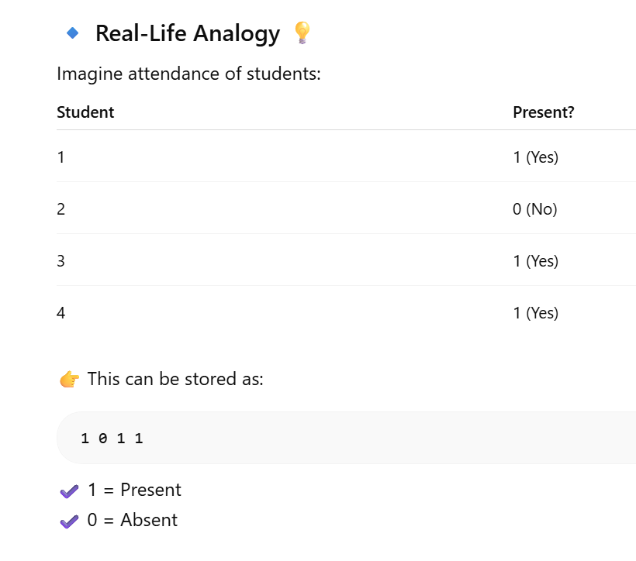
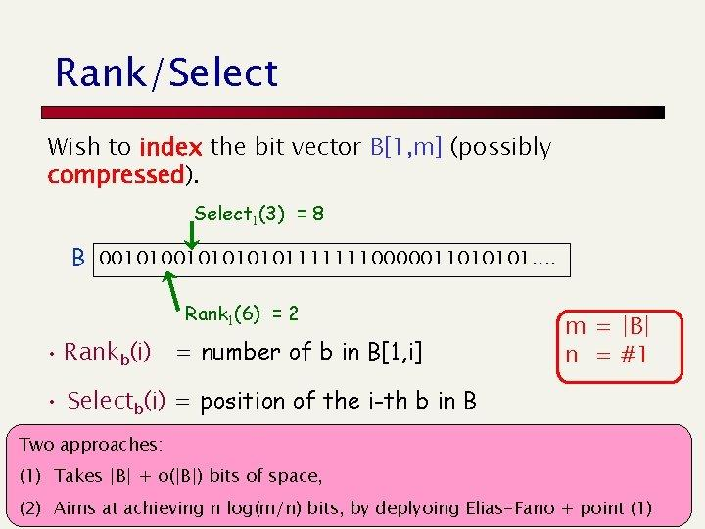
Bit Vector Succinct Representation of Data Structures
A bit vector is a compact way to store data using only 0s and 1s, and it supports operations like access, rank, and select efficiently.
Think of a bit vector as a very simple list made of only:
0 and 1
B = 1 0 1 1 0 0 1 0
Each position stores just one bit → so it uses very little memory.
Dattatray G Takale, Department of Computer engineering, VIT, Pune- 411037

Slide 5
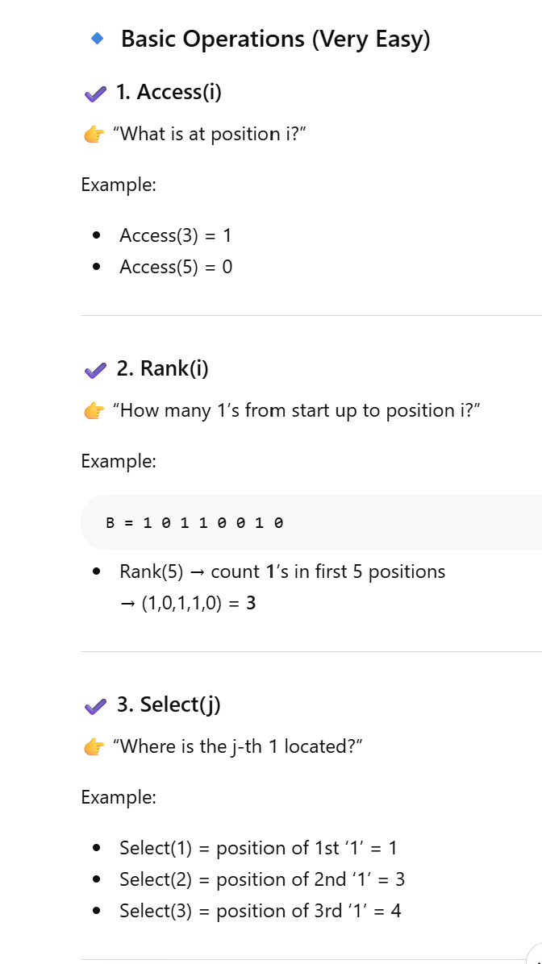
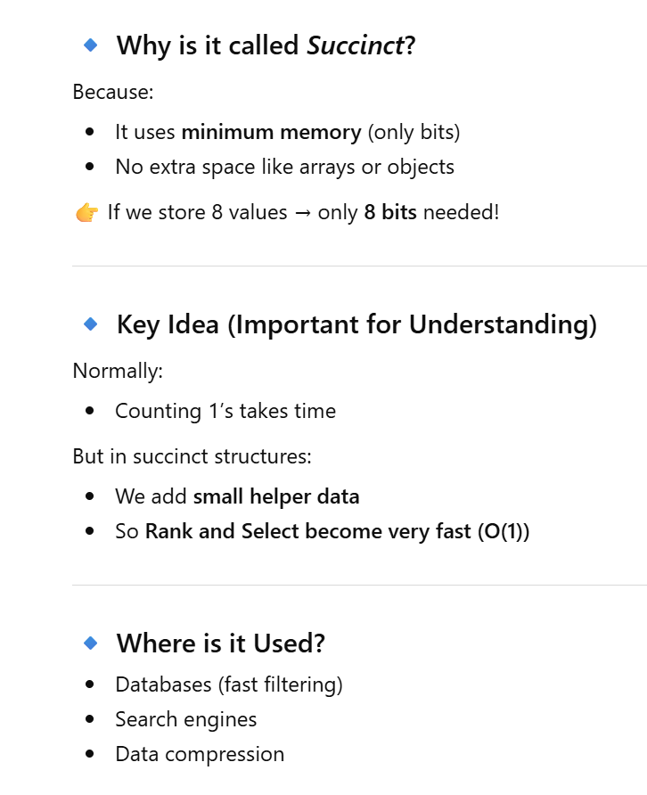
Succinct Representation of Data Structures
Dattatray G Takale, Department of Computer engineering, VIT, Pune- 411037

Slide 6
Succinct Dictionary Succinct Representation of Data Structures
A succinct dictionary stores a set using a compact bit vector and supports fast operations like membership, rank, and select.
Think of a dictionary (set) where you want to store numbers like:
S = {1, 3, 4, 7}
Instead of storing these numbers normally (which takes more memory), we store them in a compact way using bits (0 and 1).
. This compact representation is called a Succinct Dictionary.
Dattatray G Takale, Department of Computer engineering, VIT, Pune- 411037

Slide 7
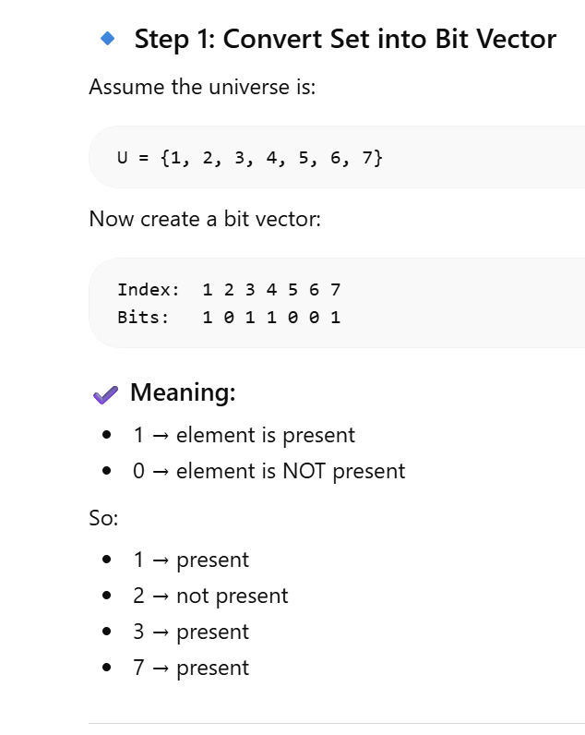
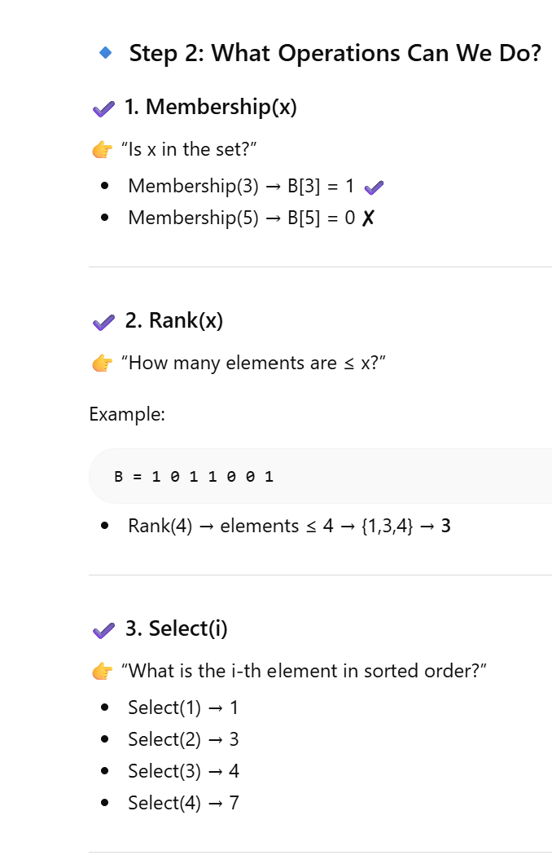
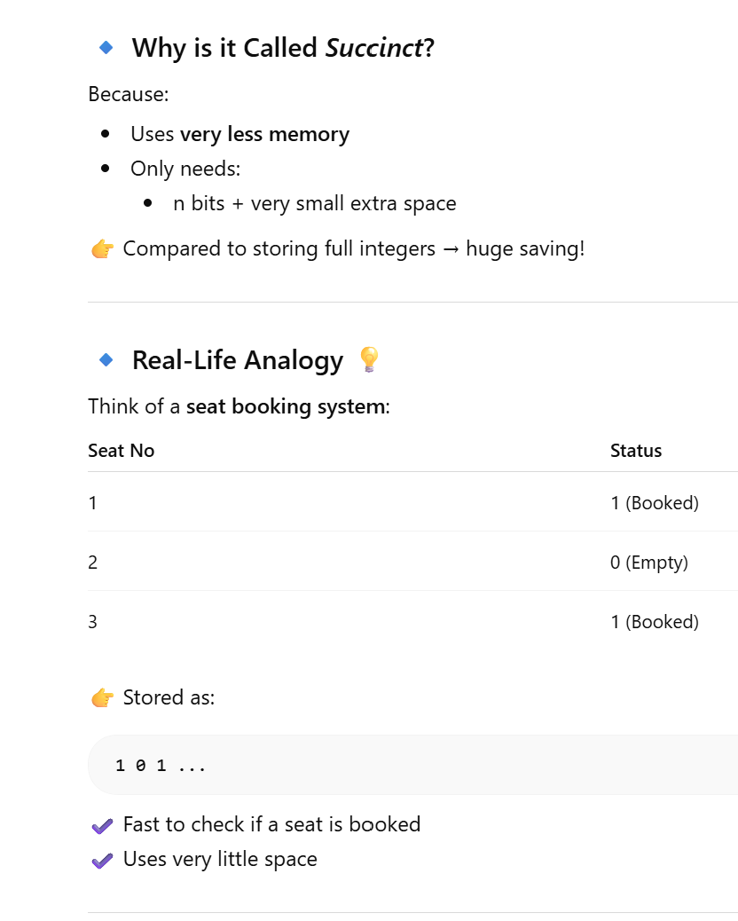
Succinct Representation of Data Structures
Dattatray G Takale, Department of Computer engineering, VIT, Pune- 411037

Slide 8
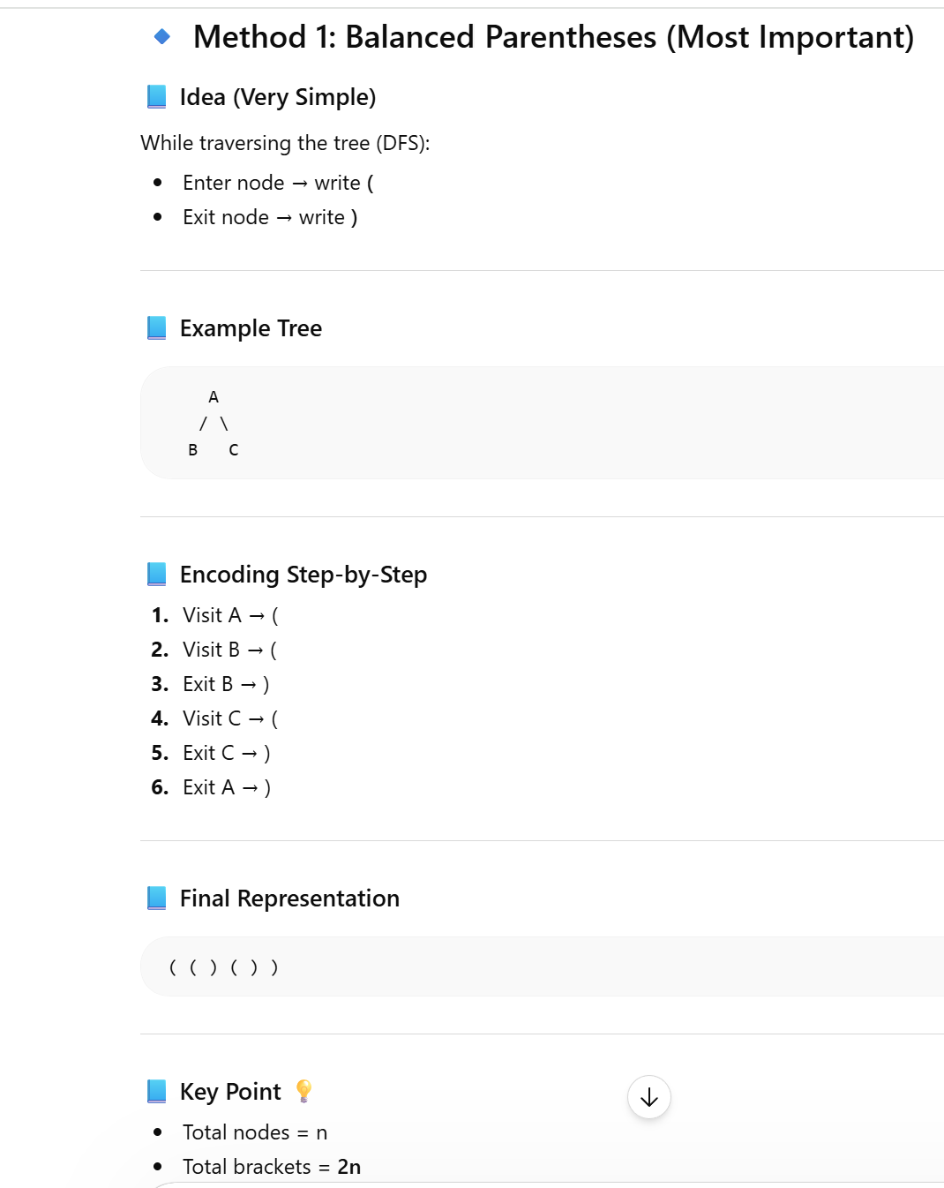
Succinct Tree Representation of Data Structures
Why do we need special tree representations?
Problem with normal trees:
Each node stores pointers (left, right, children)
Pointers take a lot of memory
For large trees → memory becomes huge ❌
Goal of Succinct Tree Representation
Store a tree using minimum bits while still allowing:
Find parent
Find children
Traverse tree
Without using pointers!
Dattatray G Takale, Department of Computer engineering, VIT, Pune- 411037

Slide 9
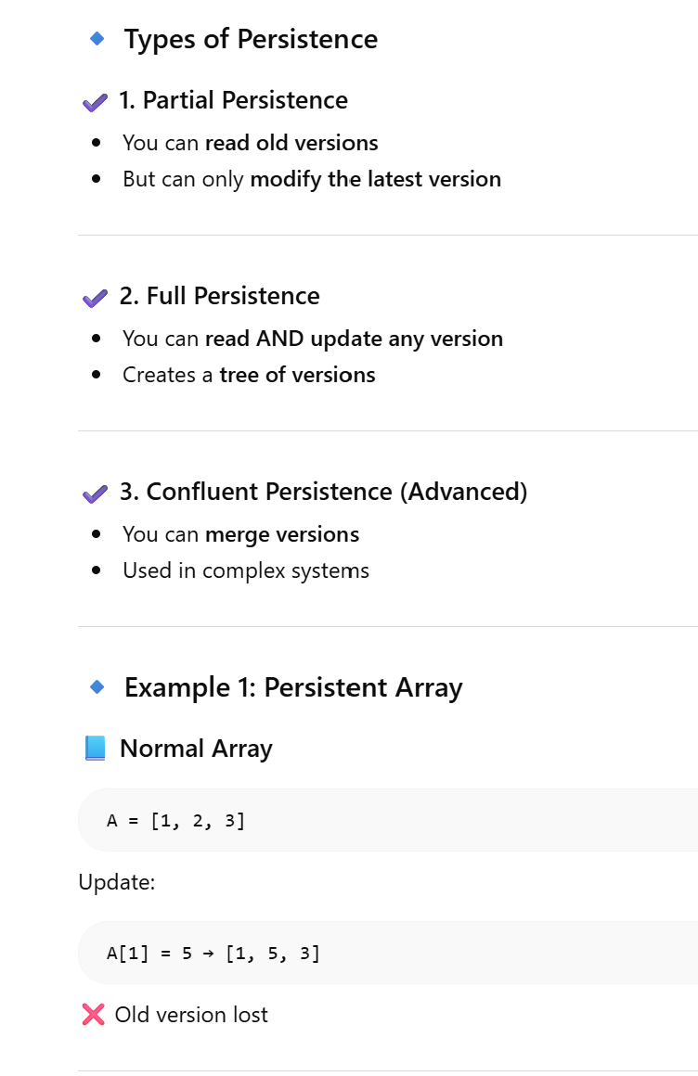
Persistent Data Structure
A persistent data structure keeps all its past versions after updates instead of overwriting them.
Every time you update it, a new version is created, and the old one is still available.
Think of Google Docs version history:
You edit a document
Old versions are still saved
You can go back anytime
Same idea in data structures!
Dattatray G Takale, Department of Computer engineering, VIT, Pune- 411037

Slide 10
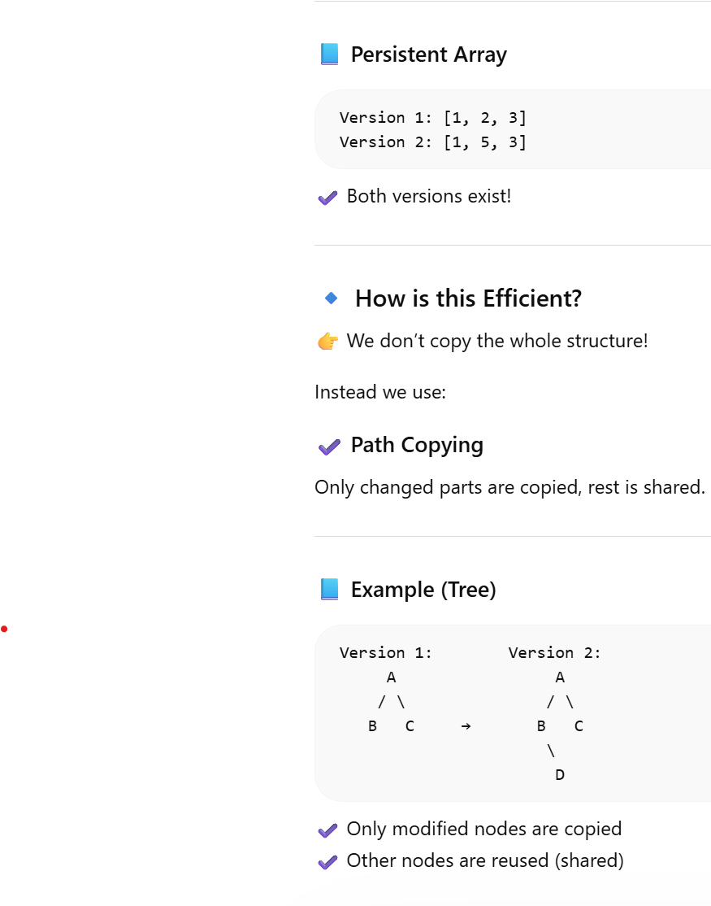
Persistent Data Structure
Dattatray G Takale, Department of Computer engineering, VIT, Pune- 411037

Slide 11
Persistent Data Structure
A persistent data structure keeps all its past versions after updates instead of overwriting them.
Every time you update it, a new version is created, and the old one is still available.
Think of Google Docs version history:
You edit a document
Old versions are still saved
You can go back anytime
Same idea in data structures!
Dattatray G Takale, Department of Computer engineering, VIT, Pune- 411037

